Slide 1










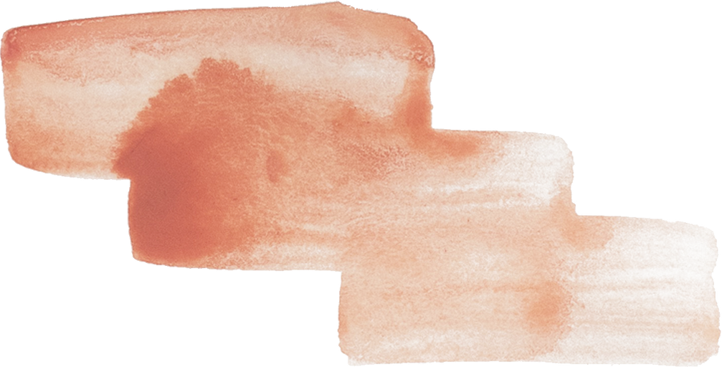
TENZING:
An SQL Implementation on MapReduce
PRESENTED BY: GROUP 29

Slide 2
Origin
Objective
The problem arised at the end of 2008 when the third party database appliance (DBMS-X) was not keeping pace with the increasing workload of queries for google Ads.
Due to the lack of meeting expectation, this enforced google to the development of Tenzing for meeting it’s needs.
And Finally over a work of 18 months, google successfully designed and implemented this as an internal tool for their purpose.
The primary objective of this report is to explore the underlying architecture of tenzing.
Explore the primary SQL features provided by tenzing.
Exploring the optimization techniques used on top of MapReduce for query optimization.
Scalability
Performance Benchmarks.
Future Enhancements.

Slide 3
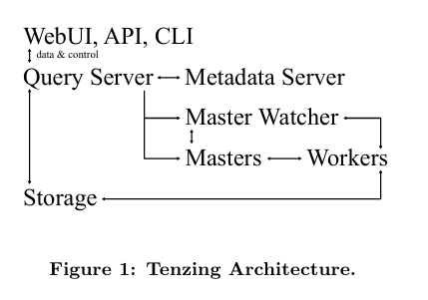
Core Architecture
Key Features
Tenzing comprises of four major components Worker pool, Query Server, Metadata Server and Client Interfaces.
Flexible with the data storage.
Provides almost all the SQL features.
Basic SQL features like SELECT, WHERE, JOINs, etc.
Optimized for in case of JOINS.
Advance SQL features like Aggregation, Analytical Functions, and many more.
OLAP Extensions.
DDL and DML support.
Views
Terminologies
Worker
Master
Metadata Server

Slide 4
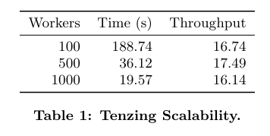
Optimizations And Benchmarks
Tenzing comes with a lot of optimization on top of MapReduce framework.
In JOINS, the optimizer tries to find the best join strategy for the given query.
Avoids unnecessary sorting in Hash-Table based aggregation.
Does caching to reduce the Network I/O.
Local Exe.
Scalability Benchmarks :-
From the scores we can see that Tenzing is highly scalable.

Slide 5
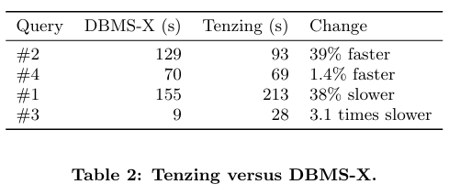
Comparison With DBMS-X :-
Following is the system configuration:
1000 Workers each with
1 CPU
2 GB RAM
8 GB Local Storage
The slower performance was due to the lack of availability of LLVM at benchmark time.

Slide 6
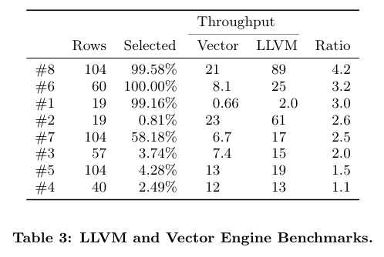
LLVM Vs Vector Engine :-
LLVM stands for Low Level Virtual Machine which does the job of optimized low level code generation.
Vector Engine is another query processing engine for low selectivity tasks.
From the scores, we can see that LLVM outperforms well compared to Vector Engine.

Slide 7
Future Enhancements
Optimization in Join Strategies
Optimization in Nested Queries
Adding New Features in Handling Structured Data
Optimization in Views for complex queries
Optimizing the user defined TVB’s(Table Valued Functinos)
Latency
Fully Integration of LLVM

Slide 8
THANK YOU !

